Slide 1


Data Analytics

Slide 2


Today's agenda
Project recap
Problem
The Analytics team
Process
Insights
Summary

Slide 3

h
Social Buzz is a fast growing technology unicorn that need to adapt quickly to a global scale.
Accenture has begun a POC focusing on:
Au audit of Social Buzz’s big data practice.
Recommendations for a successful IPO
Analysis to find Social Buss’s top 5 most popular categories of content.
Project Recap

Slide 4


Problem
Over 100000 posts per day.
36,500,00 pieces of content per year!
Hot to capitalize that large number?

Slide 5



Andrew Fleming
Chief Technical Architect
The Analytics team
Marcus Rompton
Senior Principle
Ayoub Tahiri
Data Analyst

Slide 6
Process
1
Data understanding
2
Data Cleaning
3
Data Modeling
4
Data Analysis
5
Insights

Slide 7

Insights
74965 Animal Reactions
January had the most posts: 2218
16 Unique categories

Slide 8
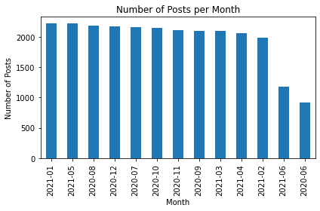

Slide 9
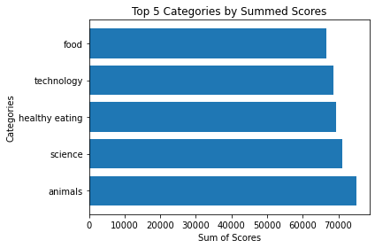

Slide 10

Analysis:
From the graph we could clearly see that the most popular categories of content are Animals and Science.
We can interpret that people might enjoy “Cute” and “Real ” content the most
Insight:
Eating or more specifically healthy eating is the most streamed. The company could this to create more ads and sponsorship posts with brands that promote such contents
Summary
What’s Next?
Following a regular schedule for evaluation and Data analysis could definitely make the difference and help the company’s competitiveness against other companies.

Slide 11

Thank you!
ANY QUESTIONS?

